Slide 1
Probability of symptom detection

Slide 2
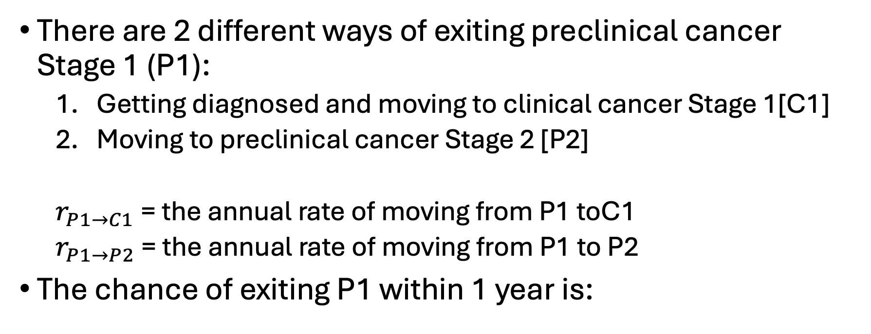
Probability of clinical detection under competing risks
There are 2 different ways of exiting preclinical cancer Stage 1 (P1):
  Getting diagnosed and moving to clinical cancer Stage 1[C1]
  Moving to preclinical cancer Stage 2 [P2]
  $r_{P1→C1}$= the annual rate of moving from P1 toC1
  $r_{P1→P2}$ = the annual rate of moving from P1 to P2
The chance of exiting P1 within 1 year is:
$$P\left(Exiting P1\right)=1−\exp\left(−\left(r_{P1→C1}+r_{P1→P2}\right)\right)$$

Slide 3


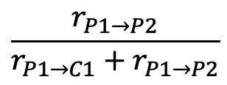
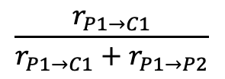
Probability of clinical detection from P1 to C1
Going to C1
$$\frac{r_{P1→C1}}{r_{P1→C1}+r_{P1→P2}}$$
Exiting P1
Pr exiting P1
$$1−\exp\left(−\left(r_{P1→C1}+r_{P1→P2}\right)\right)$$
One year
Going to P2
P1
$$\frac{r_{P1→P2}}{r_{P1→C1}+r_{P1→P2}}$$
Staying in P1
$$\exp\left(−\left(r_{P1→C1}+r_{P1→P2}\right)\right)$$
P$\left(P1→C1\right)=\frac{r_{P1→C1}}{r_{P1→C1}+r_{P1→P2}}\left(1−\exp\left(−\left(r_{P1→C1}+r_{P1→P2}\right)\right)\right)$
Notes:
No under or overestimating Pr of death of any casuses

